Slide 1
Cycle 1 Group 3
SKY RACERS
Thomas Gadek, Nicholas Knowles, Emmanuel Owusu, Jeffrey Perreault, Timothy Scott

Slide 2
Agenda
System/Cycle Intent
Design and Features
Demo
Process/Tools/Standards
Lessons Learned
Next Steps

Slide 3

System and Cycle Intent
System: Sky Racers is a fun racing game that allows users to create code controlled cars and custom tracks.
Cycle: To have code controlled cars, custom track importing and several other racing elements. This includes car and wall collision, racing physics, sound effects, a lap counter and a lap timer.
Not actual gameplay

Slide 4
Design and Features
Complex Collision (in test) Custom Map Importing (in test)
Physics (in test) Sound (code reviewed)
Lap Tracker (in test) High Score Tracking (unstarted)
Animations (in coding) Virtual Machine (in coding)
User Interface (unstarted)
Notes:
Quickly name each feature and tell the progress, nothing else

Slide 5
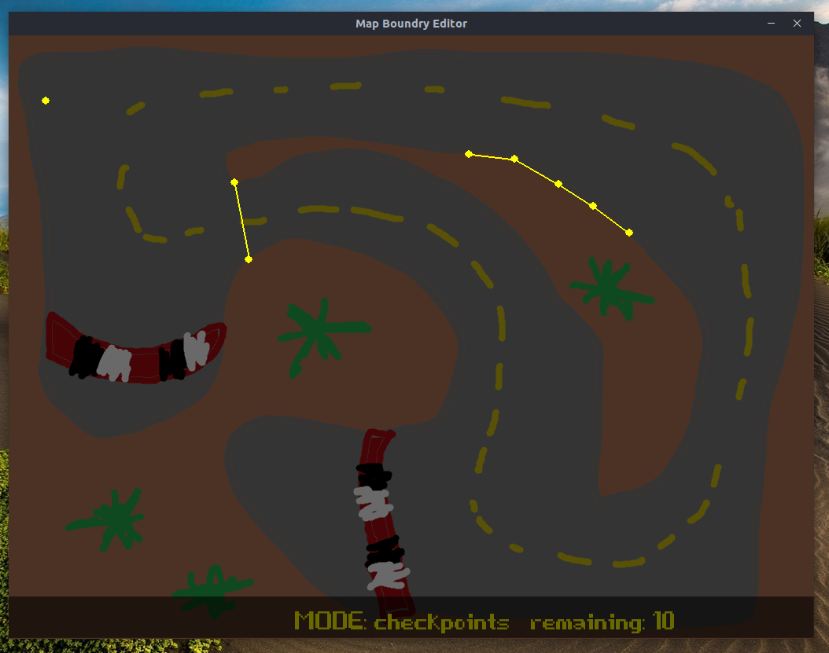
Custom Map Importing
There is a level editor program that allows the user to upload their own map image and create boundaries, checkpoints and start positions needed for gameplay
Constraints:
The image has to be a png file with the dimensions 1024, 768

Slide 6
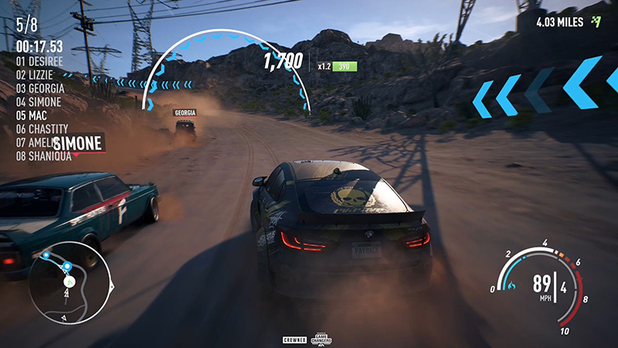
Lap Tracker
Tracks checkpoint progress and lap count. Also tracks total race time, current lap time, and best lap time.
Constraints: None
Not actual gameplay

Slide 7
Virtual Machine
The user creates a text file that includes statements of how the car should act. The input can have if statements and commands that the user writes. The input decides if the distance or angle from a wall or checkpoint is within the set parameters. If not, the car will turn to correct itself and reach the set parameters.
Constraints:
-Limited number of AI commands to input
-The current AI doesn’t fully compensate for added movement from the physics engine
-Too much user input may cause system lag in older devices

Slide 8
Demo

Slide 9


Process/Tools/Standards
Bit Bucket was used for code organization and management
Weekly Status Reports, hours and feature progress
Testing and code review of every completed feature
Not actual test or code review process

Slide 10

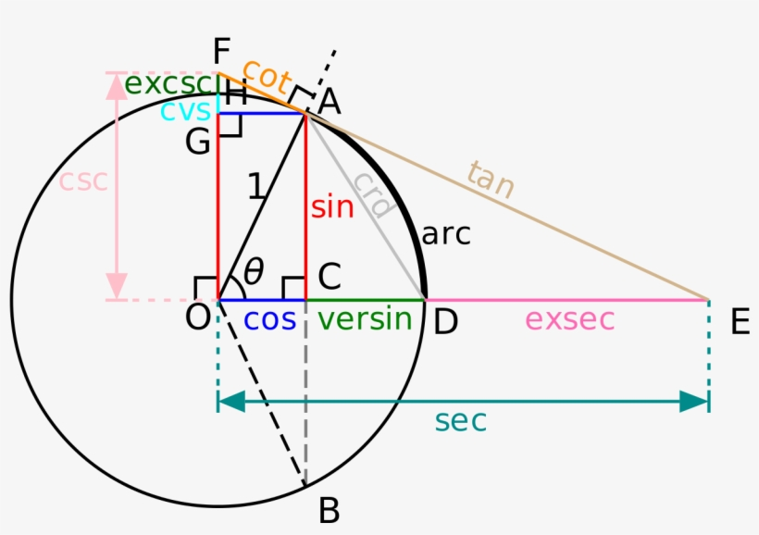
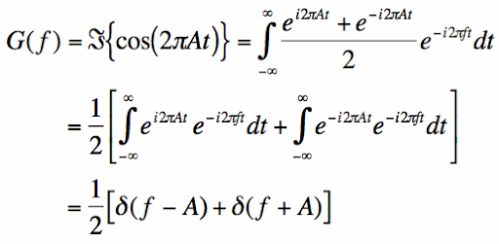
Lessons Learned
Importing modules from anywhere within a python project
Angle calculations to track car to walls and checkpoint relations, along with direction to walls and checkpoint.
Notes:
Python logo, very basic trig, and very basic fourier transform of a cosine wave, won’t bore you with this easy stuff. Fourier breaks down a waves sin and cos components. Output represents the freq domain.

Slide 11

Next Steps
Cycle 2: We expect to focus on testing our features and doing code review more often as we finish coding and complete more features. We also expect to finish coding our VM.
Cycle 3: We expect to have all testing and coding completed and a complete game.
Not actual gameplay

